Slide 1
PRONTO! PREDICTED
BY EVAN SADLER

Slide 2

MY BIKE

Slide 3
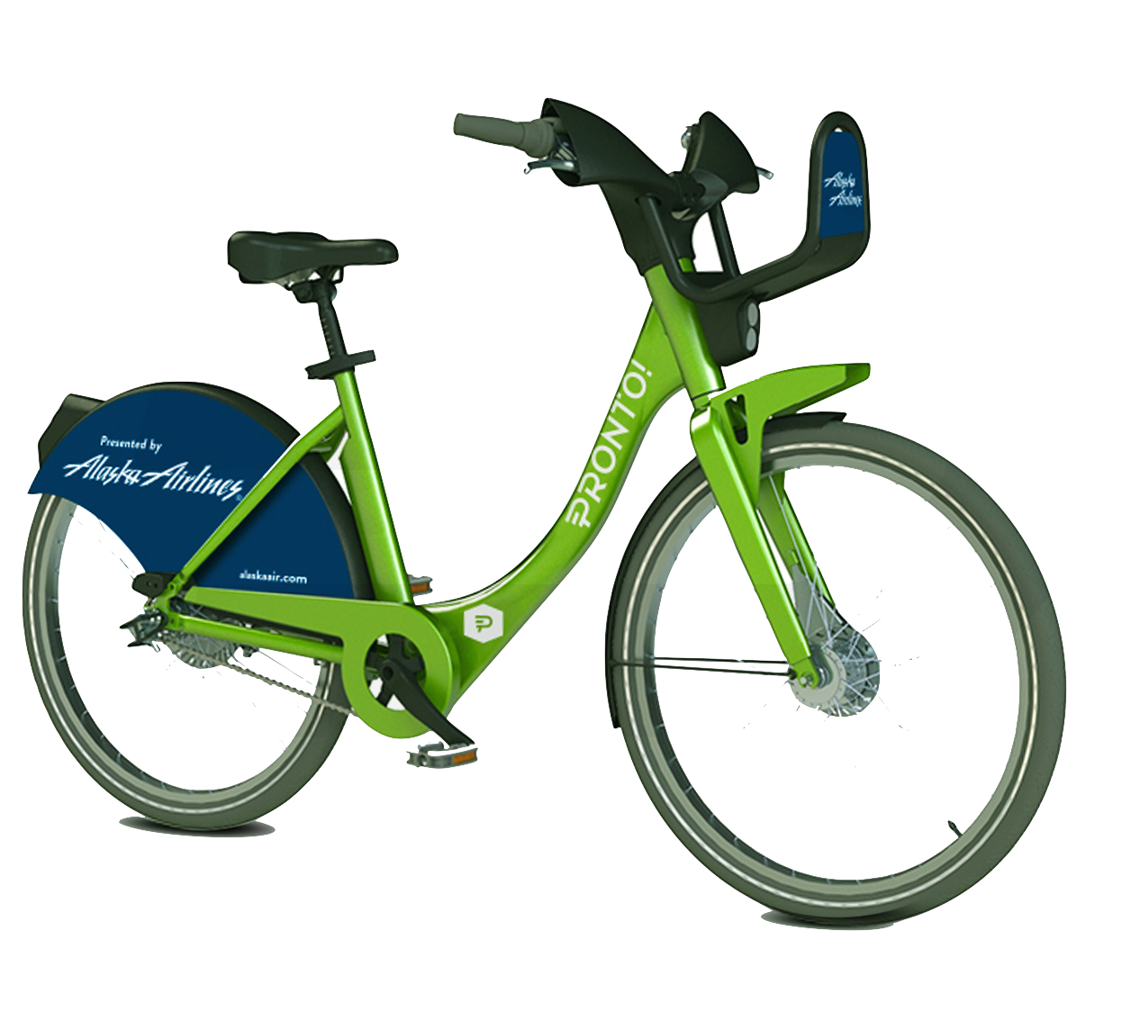
PRONTO
$10 monthly for unlimited bike rentals under 30 minutes

Slide 4
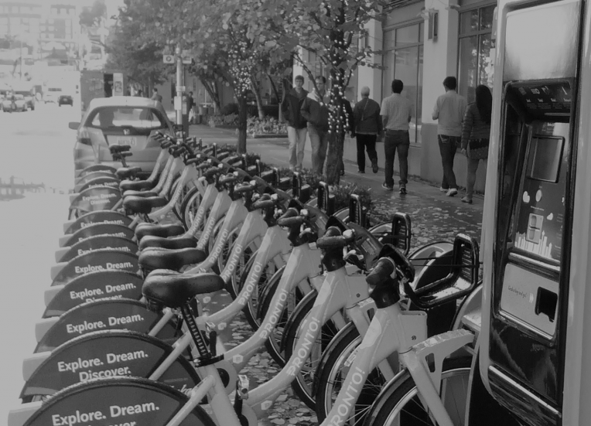
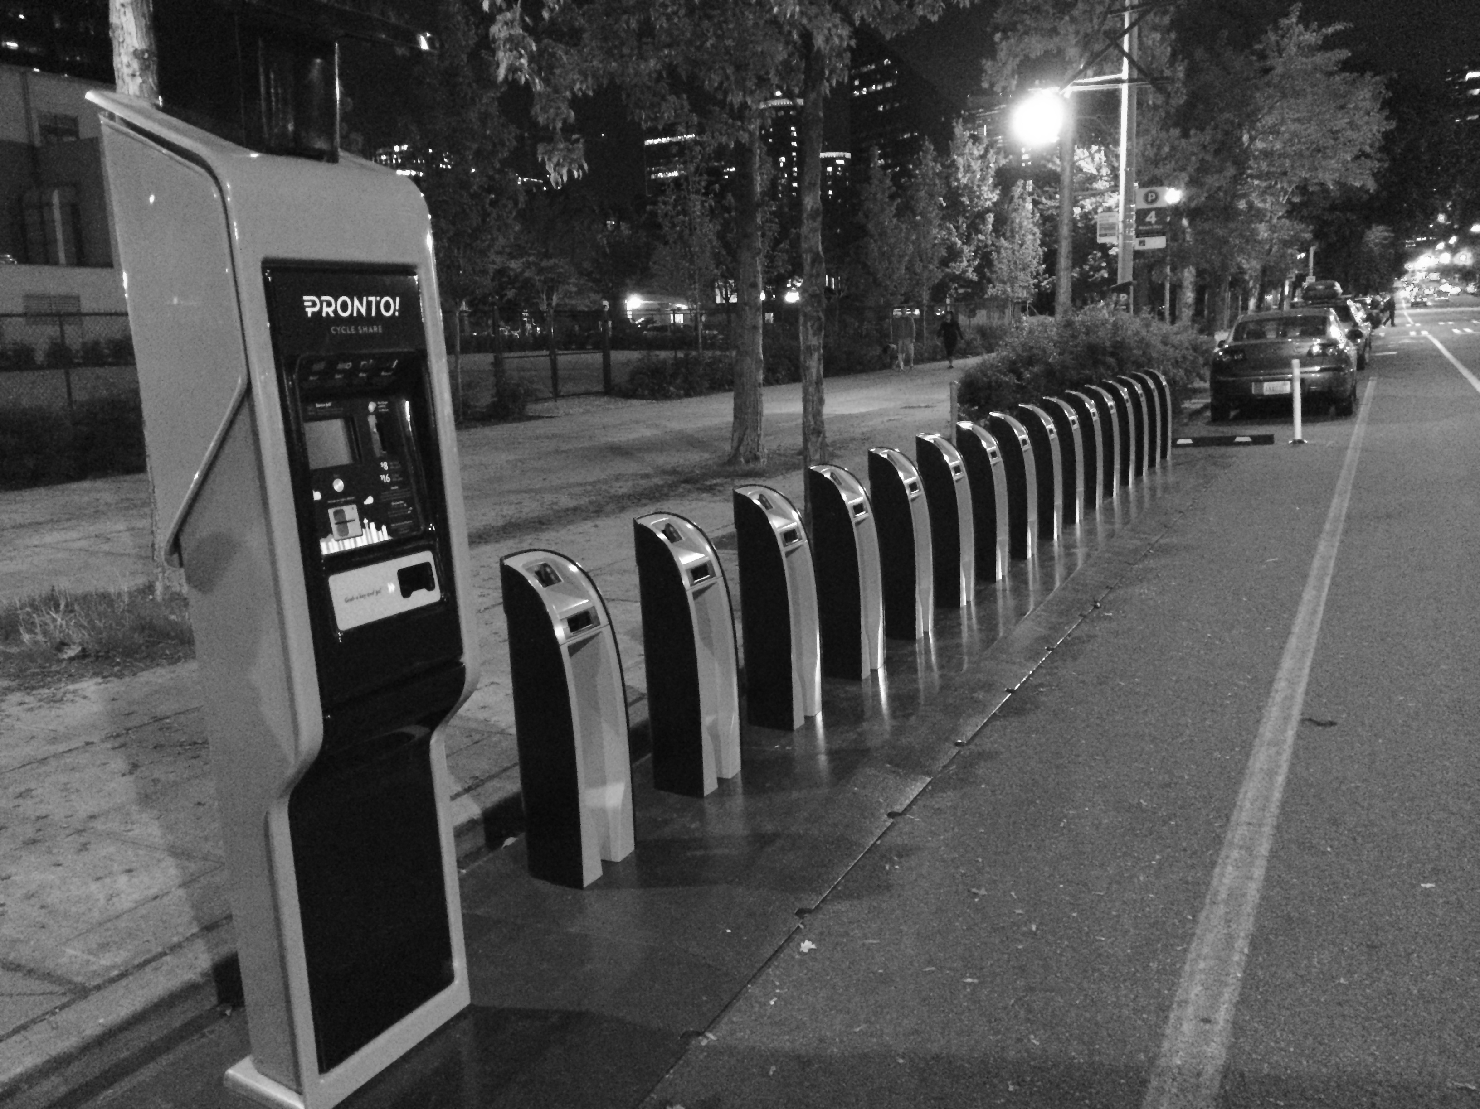
PROBLEM

Slide 5
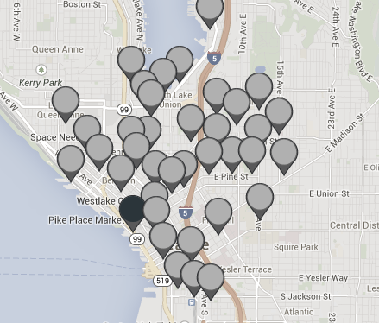
Challenges
50 stations
Weather + Elevation
One dispatcher
No predictive analytics

Slide 6

Data Pipeline
Date-time | Start Terminal | End Terminal
1/12/2015 07:55:52 | CH-04 | SLU-02
1/12/2015 08:00:33 | CH-04 | BT-02
Aggregate
Impute zeros
Bin hours
Hourly Weather
Elevation
Lags & Meta
Date | Time | Terminal | Total Demand
1/12/2015 | Commute to work | CH-04 | 2
1/12/2015 | Commute to work | PS-01 | 0
Date | Time | Terminal | Total Supply
1/12/2015 | Commute to work | CH-04 | 0
1/12/2015 | Commute to work | PS-01 | 4

Slide 7
FORECASTING INVENTORY
Supply Data
Supply Model
Demand Data
Demand Model
Available
Departing
Future Inventory
Arriving
JSON Feed
With bounds of 0 and terminal size

Slide 8
PREDICTIVE MODEL
Random Forest
0
≥1
1-2
3-4
5-8
8-15
Random Forest
Data

Slide 9
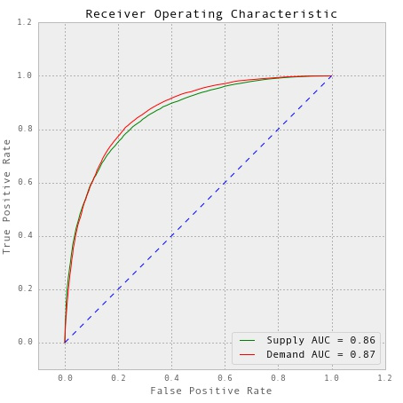
Results
AUC: 0.87 & 0.86
Accuracy: 62% (4 classes)
Important Features
Lagged Averages
Temp, Dew, Wind
Elevation

Slide 10
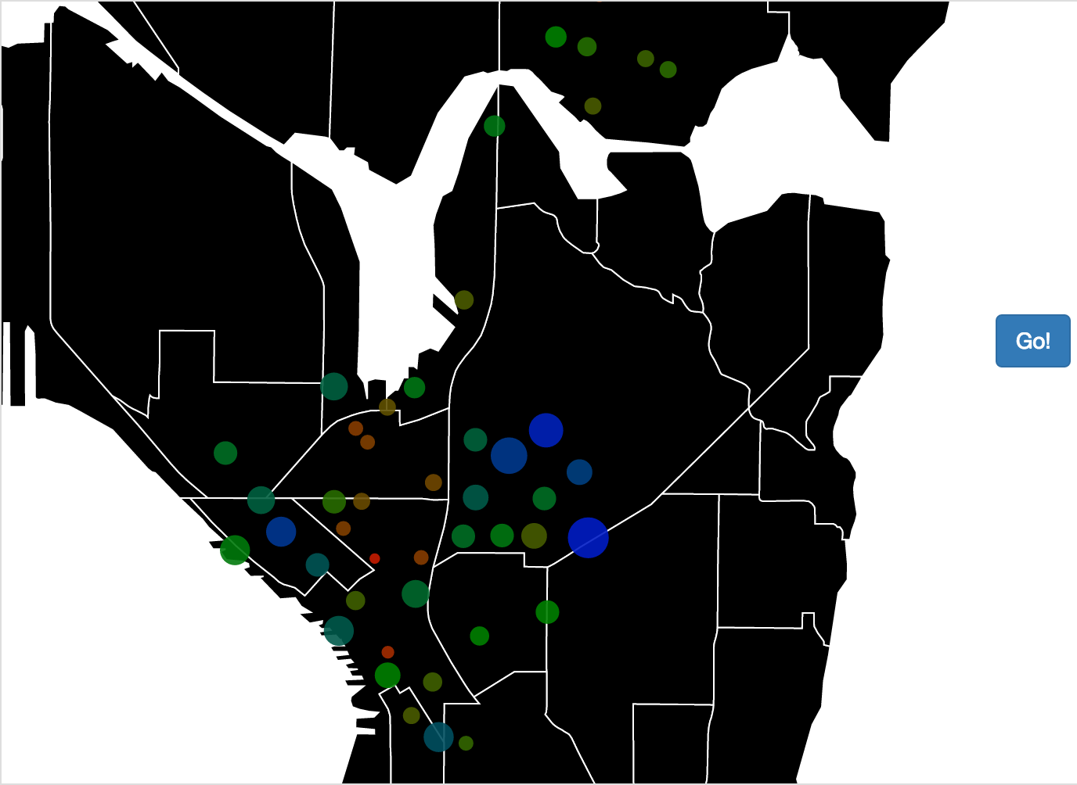


Next
Recommendations
Finish web app
Get user IDs

Slide 11
THANK YOU
Evan Sadler
evansadler.me
github.com/easadler/capstone

